Slide 1
Right Triangle Trigonometry
Geometry
Chapter 7
Notes:
Geometry 7

Slide 2
This Slideshow was developed to accompany the textbook
  Larson Geometry
  By Larson, R., Boswell, L., Kanold, T. D., & Stiff, L.
  2011 Holt McDougal
Some examples and diagrams are taken from the textbook.
Slides created by
Richard Wright, Andrews Academy
rwright@andrews.edu

Slide 3
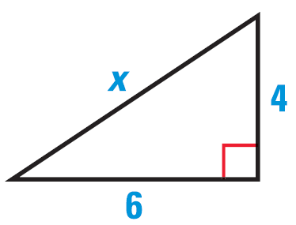
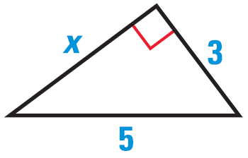
7.1 Apply the Pythagorean Theorem
Pythagorean Theorem
In a right triangle, a² + b² = c² where a and b are the length of the legs and c is the length of the hypotenuse.
Find the value of x
Notes:
$$3^{2}+x^{2}=5^{2}$$
$$9+x^{2}=25$$
$$x^{2}=16$$
$$x=4$$
$$6^{2}+4^{2}=x^{2}$$
$$36+16=x^{2}$$
$$52=x^{2}$$
$$x=2\sqrt{13}$$

Slide 4
7.1 Apply the Pythagorean Theorem
The top of a ladder rests against a wall, 23 ft above the ground. The base of the ladder is 6 ft away from the wall. What is the length of the ladder.
Notes:
$${23}^{2}+6^{2}=x^{2}$$
$$529+36=x^{2}$$
$$565=x^{2}$$
$$x=23.77 ft$$

Slide 5
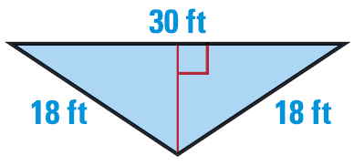
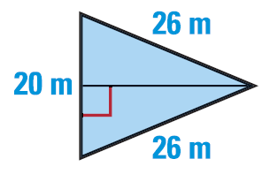
7.1 Apply the Pythagorean Theorem
Find the area of the triangle
Notes:
Use pythagorean theorem to find height: ${15}^{2}+h^{2}={18}^{2}$
$$225+h^{2}=324$$
$$h^{2}=99$$
$$h=3\sqrt{11}$$
$$A=\frac{1}{2}bh=\frac{1}{2}\left(30\right)\left(3\sqrt{11}\right)=45\sqrt{11}=149ft^{2}$$
Find height: ${10}^{2}+h^{2}={26}^{2}$
$$100+h^{2}=676$$
$$h^{2}=576$$
$$h=24$$
$$A=\frac{1}{2}\left(20\right)\left(24\right)=240m^{2}$$

Slide 6
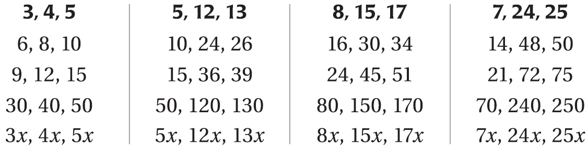
7.1 Apply the Pythagorean Theorem
Pythagorean Triples
  A set of three positive integers that satisfy the Pythagorean Theorem

Slide 7
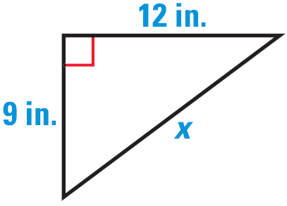
7.1 Apply the Pythagorean Theorem
Use a Pythagorean Triple to solve
436 #4-34 even, 40-50 even = 22
Notes:
Triple is 9, 12, 15
x = 15

Slide 8
Answers and Quiz
7.1 Answers
7.1 Homework Quiz

Slide 9
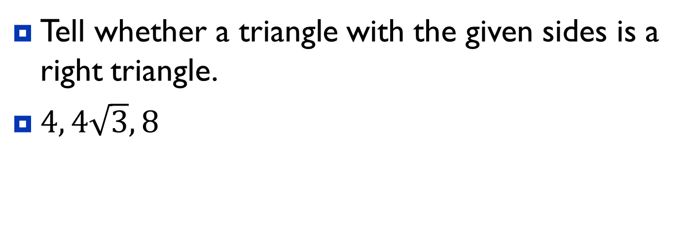
7.2 Use the Converse of the Pythagorean Theorem
Converse of the Pythagorean Theorem
If a² + b² = c² where a and b are the length of the short sides and c is the length of the longest side, then it is a right triangle.
Tell whether a triangle with the given sides is a right triangle.
$4, 4\sqrt{3}, 8$
Notes:
$$4^{2}+{\left(4\sqrt{3}\right)}^{2}=8^{2}$$
$$16+\left(16\right)\left(3\right)=64$$
$$16+48=64$$
$$64=64$$
Yes

Slide 10
7.2 Use the Converse of the Pythagorean Theorem
If c is the longest side and…
c² < a² + b² → acute triangle
c² = a² + b² → right triangle
c² > a² + b² → obtuse triangle
Show that the segments with lengths 3, 4, and 6 can form a triangle
Classify the triangle as acute, right or obtuse.
444 #2-30 even, 33, 38, 40, 44-52 even = 23
Extra Credit 447 #2, 8 = +2
Notes:
$$3+4>6$$
$$7>6$$
$$3^{2}+4^{2} \underline{?} 6^{2}$$
$$9+16 \underline{?} 36$$
$$25<36$$
obtuse

Slide 11
Answers and Quiz
7.2 Answers
7.2 Homework Quiz

Slide 12
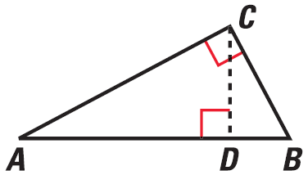
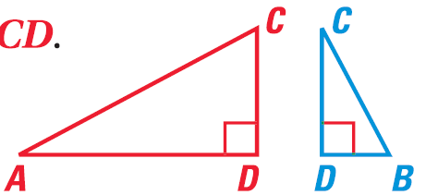
7.3 Use Similar Right Triangles
If the altitude is drawn to the hypotenuse of a right triangle, then the two triangles formed are similar to the original triangle and to each other.
ΔCBD ~ ΔABC, ΔACD ~ ΔABC, ΔCBD ~ ΔACD

Slide 13
7.3 Use Similar Right Triangles
Identify the similar triangles. Then find x.
E
E
E
H
H
H
5
5
3
3
3
x
x
x
G
G
G
G
F
F
F
4
4
4
Notes:
ΔEFG ~ ΔGFH ~ ΔEHG
$$\frac{GH}{EG}=\frac{GF}{EF}$$
$$\frac{x}{3}=\frac{4}{5}$$
$$x=\frac{12}{5}$$

Slide 14
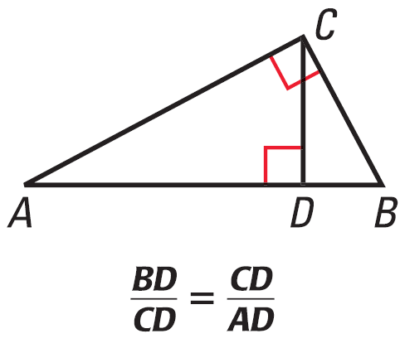
7.3 Use Similar Right Triangles
If the altitude is drawn to the hypotenuse of a right triangle, then the altitude is the geometric mean of the two segments of the hypotenuse.

Slide 15
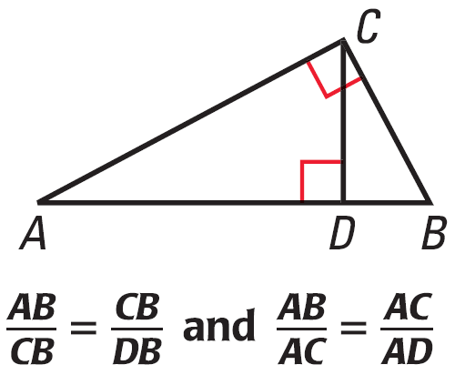
7.3 Use Similar Right Triangles
If the altitude is drawn to the hypotenuse of a right triangle, then each leg is the geometric mean of the hypotenuse and the segment of the hypotenuse adjacent to that leg.

Slide 16
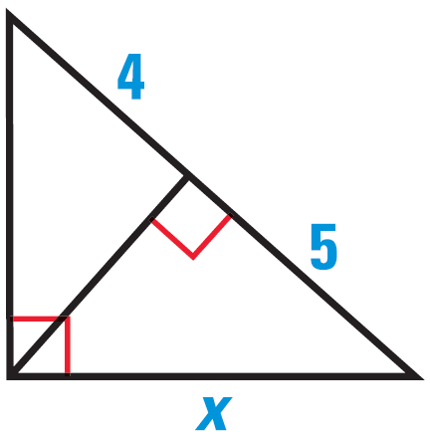
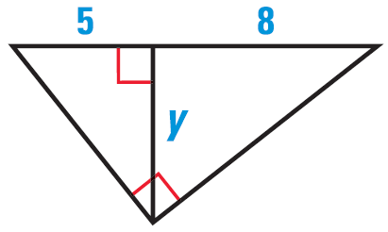
7.3 Use Similar Right Triangles
Find the value of x or y.
453 #4-26 even, 30-34 even, 40-48 even = 20
Notes:
$$\frac{x}{9}=\frac{5}{x}$$
$$x^{2}=45$$
$$x=3\sqrt{5}=6.708$$
$$\frac{y}{5}=\frac{8}{y}$$
$$y^{2}=40$$
$$y=2\sqrt{10}=6.325$$

Slide 17
Answers and Quiz
7.3 Answers
7.3 Homework Quiz

Slide 18
7.4 Special Right Triangles
Some triangles have special lengths of sides, thus in life you see these triangles often such as in construction.

Slide 19

7.4 Special Right Triangles
45°-45°-90°
If you have another 45°-45°-90° triangle, then use the fact that they are similar and use the proportional sides.
The leg of one 45°-45°-90° triangle is 10. Find the lengths of the other sides.
45°
$$\sqrt{2}$$
1
45°
1
Notes:
ANS: other leg is 10, and hypotenuse is found by 10/1 = x/√2 → x = 10√2

Slide 20

7.4 Special Right Triangles
60°
30°-60°-90°
The hypotenuse of a 30°-60°-90° is 4. Find the lengths of the other sides.
461 #2-20 even, 24, 28, 30, 36-38 all, 40, 42-44 all = 20
Extra Credit 464 #2, 4 = +2
1
2
30°
$$\sqrt{3}$$
Notes:
ANS: 2 and 2√3

Slide 21
Answers and Quiz
7.4 Answers
7.4 Homework Quiz

Slide 22
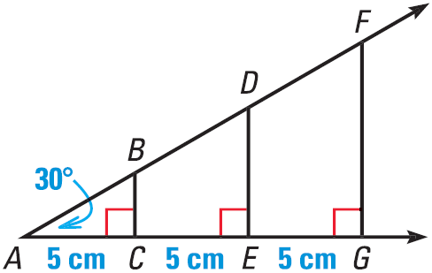
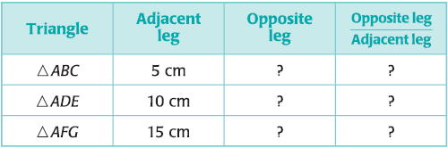
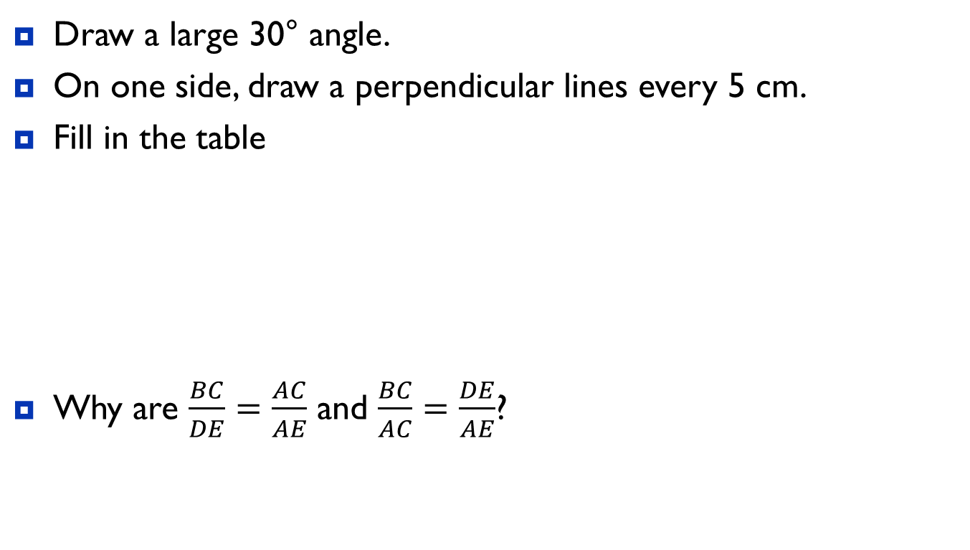
7.5 Apply the Tangent Ratio
Draw a large 30° angle.
On one side, draw a perpendicular lines every 5 cm.
Fill in the table
Why are $\frac{BC}{DE}=\frac{AC}{AE}$ and $\frac{BC}{AC}=\frac{DE}{AE}$?
Notes:
The triangles are similar by AA similarity

Slide 23
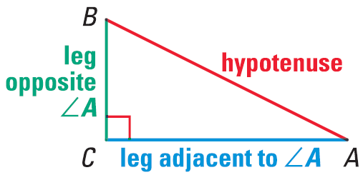
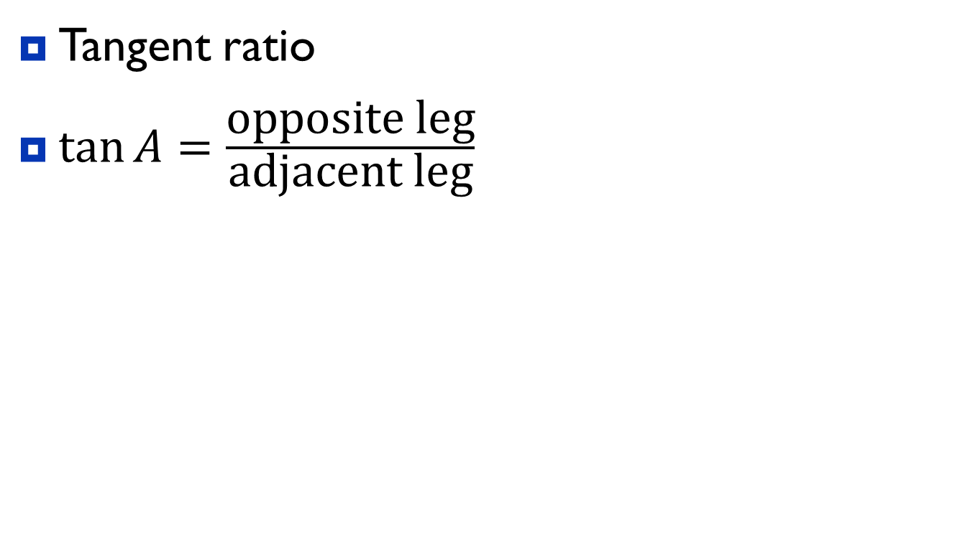
7.5 Apply the Tangent Ratio
Tangent ratio
$\tan{A=\frac{\text{opposite} \text{leg}}{\text{adjacent} \text{leg}}}$

Slide 24
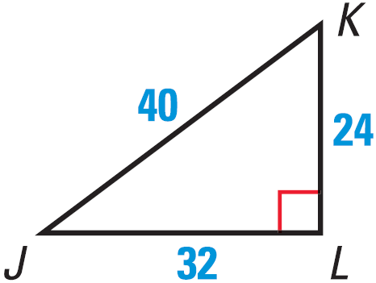
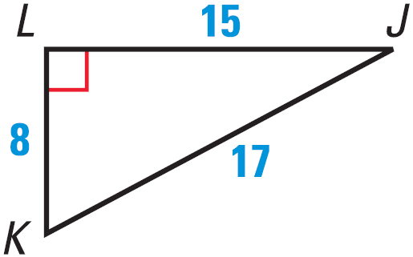
7.5 Apply the Tangent Ratio
Find tan J and tan K.
Notes:
$$\tan{J}=\frac{24}{32}=\frac{3}{4}$$
$$\tan{K}=\frac{32}{24}=\frac{4}{3}$$
$$\tan{J}=\frac{8}{15}$$
$$\tan{K}=\frac{15}{8}$$

Slide 25
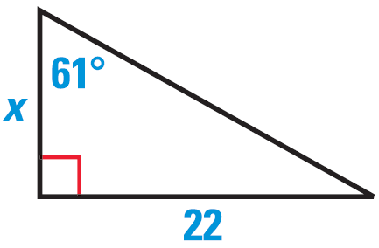
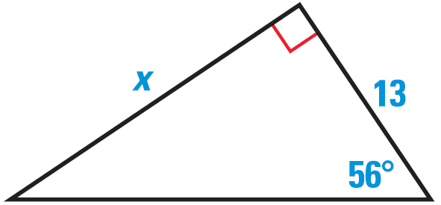
7.5 Apply the Tangent Ratio
Find the value of x. Round to the nearest tenth.
469 #4-28 even, 32, 36-46 even = 20
Notes:
$$\tan{61°}=\frac{22}{x}$$
$$x\tan{61°}=22$$
$$x=\frac{22}{\tan{61°}}=12.2$$
$$\tan{56°}=\frac{x}{13}$$
$$13 tan{56°}=x=19.3$$

Slide 26
Answers and Quiz
7.5 Answers
7.5 Homework Quiz

Slide 27

7.6 Apply the Sine and Cosine Ratios
$\sin{A}=\frac{\text{opposite} \text{leg}}{\text{hypotenuse}}$
$\cos{A}=\frac{\text{adjacent} \text{leg}}{\text{hypotenuse}}$
S O H
C A H
T O A
Notes:
SOH = Sine Opposite Hypotenuse
CAH = Cosine Adjacent Hypotenuse
TOA = Tangent Opposite Adjacent

Slide 28
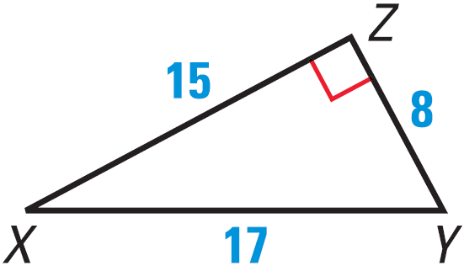
7.6 Apply the Sine and Cosine Ratios
Find sin X, cos X, and tan X
Notes:
$$\sin{X}=\frac{8}{17}$$
$$\cos{X}=\frac{15}{17}$$
$$\tan{X}=\frac{8}{15}$$

Slide 29
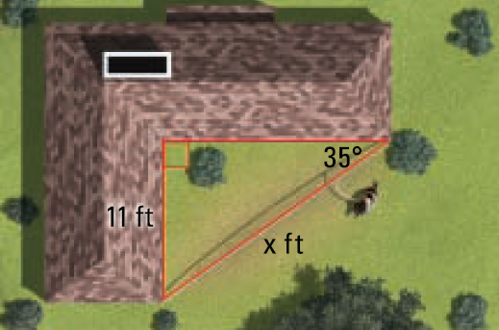
7.6 Apply the Sine and Cosine Ratios
Find the length of the dog run (x).
Notes:
$$\sin{35°}=\frac{11}{x}$$
$$x⋅\sin{35°}=11$$
$$x=\frac{11}{\sin{35°}}=19.2 ft$$

Slide 30
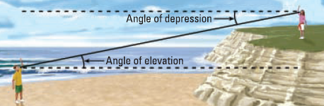
7.6 Apply the Sine and Cosine Ratios
Angle of Elevation and Depression
  Both are measured from the horizontal
  Since they are measured to || lines, they are =̃

Slide 31
7.6 Apply the Sine and Cosine Ratios
The angle of elevation of a plane as seen from the airport is 50°. If the plane’s 1000 ft away, how high is plane?
477 #2-30 even, 34, 36, 42-48 even = 21
1000 ft
x
50°
Notes:
$$\sin{50°}=\frac{x}{1000}$$
$$1000⋅\sin{50°}=x$$
$$x=766ft$$

Slide 32
Answers and Quiz
7.6 Answers
7.6 Homework Quiz

Slide 33
7.7 Solve Right Triangles
Solve a triangle means to find all the unknown angles and sides.
  Can be done for a right triangle if you know
    2 sides
    1 side and 1 acute angle
  Use sin, cos, tan, Pythagorean Theorem, and Angle Sum Theorem

Slide 34
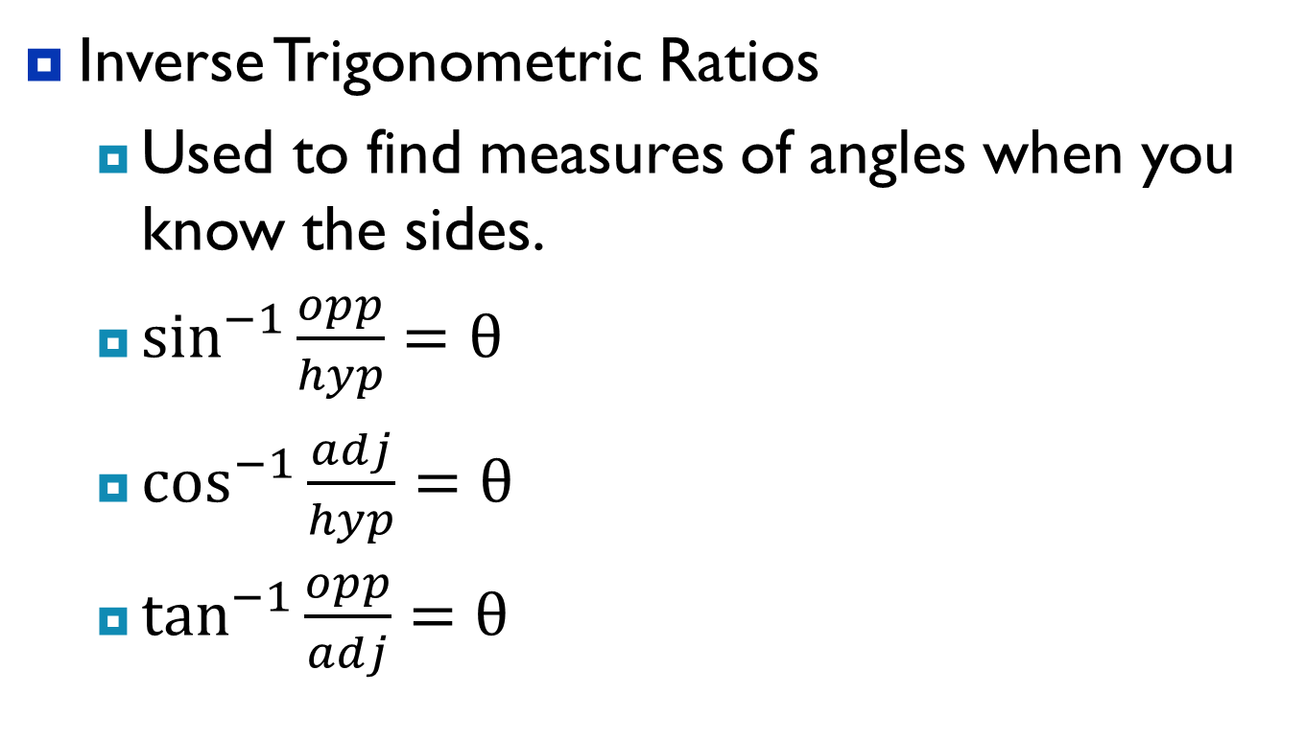
7.7 Solve Right Triangles
Inverse Trigonometric Ratios
  Used to find measures of angles when you know the sides.
  $\sin^{−1}{\frac{opp}{hyp}}=θ$
  $\cos^{−1}{\frac{adj}{hyp}}=θ$
  $\tan^{−1}{\frac{opp}{adj}}=θ$

Slide 35
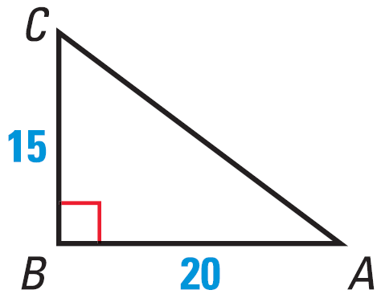

7.7 Solve Right Triangles
Find $m∠D$ to the nearest tenth if $\sin{D}=0.54$
Find $m∠C$ to the nearest tenth.
Notes:
$$D=\sin^{−1}{0.54}=32.7$$
$$C=\tan^{−1}{\frac{20}{15}}=53.1$$

Slide 36
7.7 Solve Right Triangles
Solve a right triangle that has a 40° angle and a 20 inch hypotenuse.
485 #2-28 even, 32-38 even, 43, 44-48 even = 22
Extra Credit 489 #2, 4 = +2
B
20
40°
C
A
Notes:
$$40°+B+90°=180°$$
$$B=50°$$
$$\cos{40°}=\frac{AC}{20}$$
$$AC=20\cos{40°}=15.3$$
$$\sin{40°}=\frac{BC}{20}$$
$$BC=20\sin{40°}=12.9$$

Slide 37
Answers and Quiz
7.7 Answers
7.7 Homework Quiz

Slide 38
7.Extension Law of Sines and Law of Cosines
Tangent, Sine, and Cosine are only for right triangles
Law of Sines and Law of Cosines are for any triangle

Slide 39
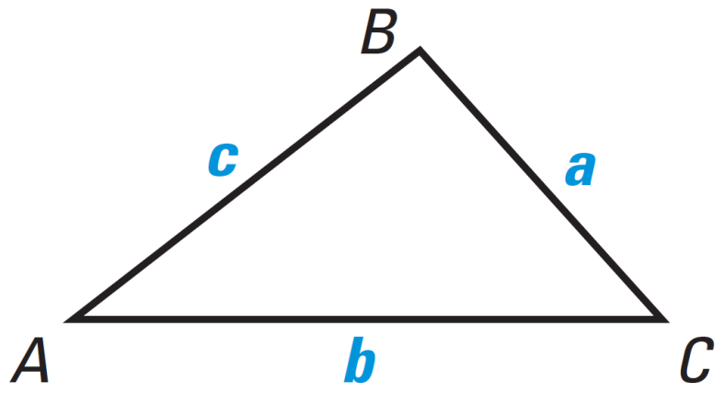
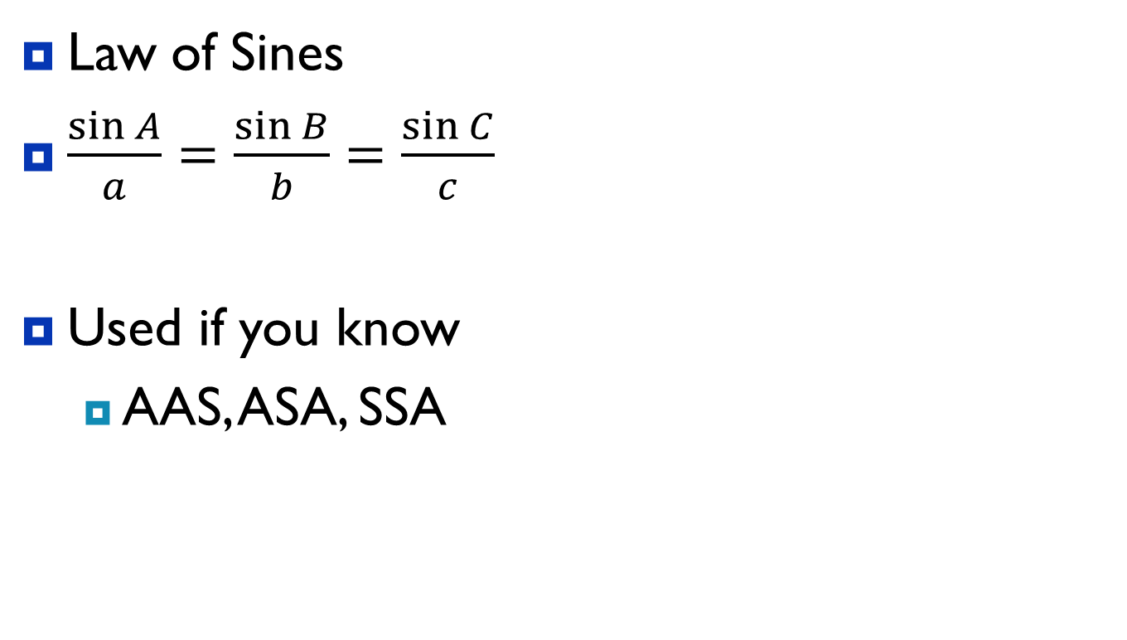
7.Extension Law of Sines and Law of Cosines
Law of Sines
$\frac{\sin{A}}{a}=\frac{\sin{B}}{b}=\frac{\sin{C}}{c}$
Used if you know
  AAS, ASA, SSA
Notes:
Only use two of the ratios at a time.

Slide 40
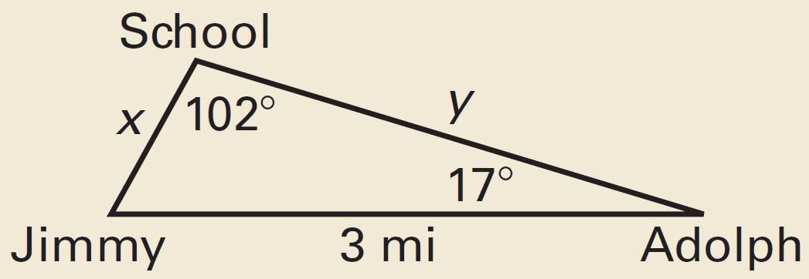
7.Extension Law of Sines and Law of Cosines
How much closer to school does Jimmy live than Adolph?
Notes:
Find x: $\frac{\sin{102°}}{3}=\frac{\sin{17°}}{x}$
$$x⋅\sin{102°}=3⋅\sin{17°}$$
$$x=\frac{3⋅\sin{17°}}{\sin{102°}}=0.897$$
Find $∠J$: $∠J=180°−102°−17°=61°$
Find y: $\frac{\sin{102°}}{3}=\frac{\sin{61°}}{y}$
$$y⋅\sin{102°}=3⋅\sin{61°}$$
$$y=\frac{3⋅\sin{61°}}{\sin{102°}}=2.682$$
Subtract: $2.682−0.897=1.785 miles$

Slide 41

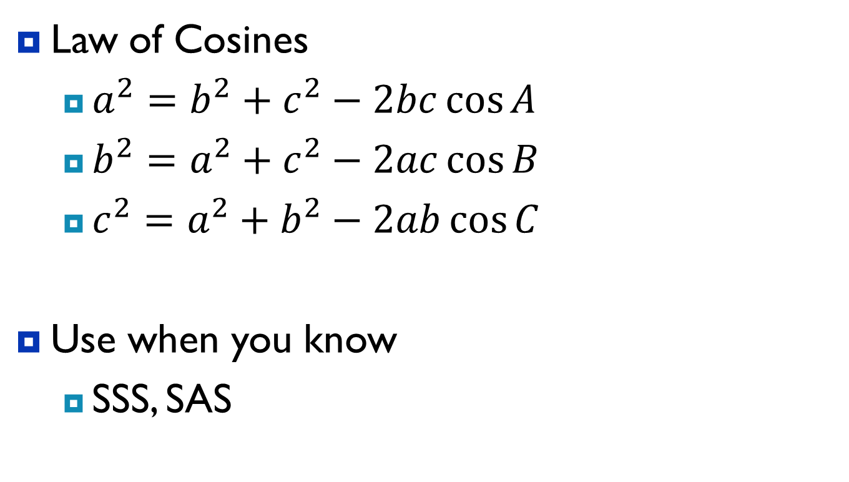
7.Extension Law of Sines and Law of Cosines
Law of Cosines
  $a^{2}=b^{2}+c^{2}−2bc\cos{A}$
  $b^{2}=a^{2}+c^{2}−2ac\cos{B}$
  $c^{2}=a^{2}+b^{2}−2ab\cos{C}$
Use when you know
  SSS, SAS

Slide 42
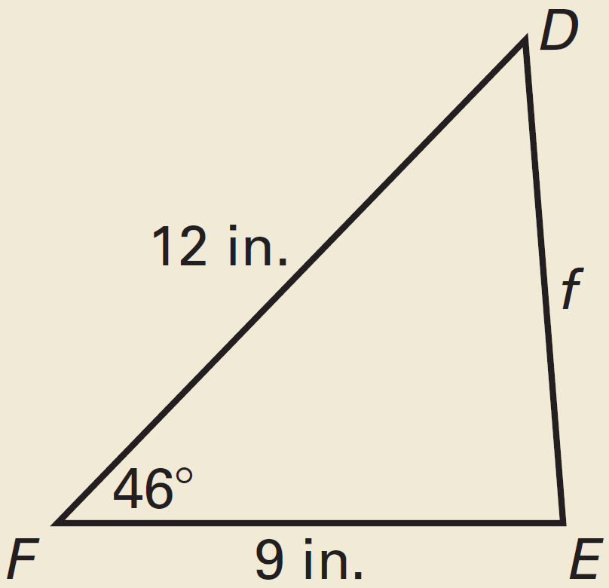
7.Extension Law of Sines and Law of Cosines
Find f to the nearest hundredth.
491 #1-7 = 7
Notes:
$$f^{2}=9^{2}+{12}^{2}−2⋅9⋅12⋅\cos{46°}$$
$$f^{2}=74.9538$$
$$f=8.66 in$$

Slide 43
Answers
7.Extension Answers

Slide 44
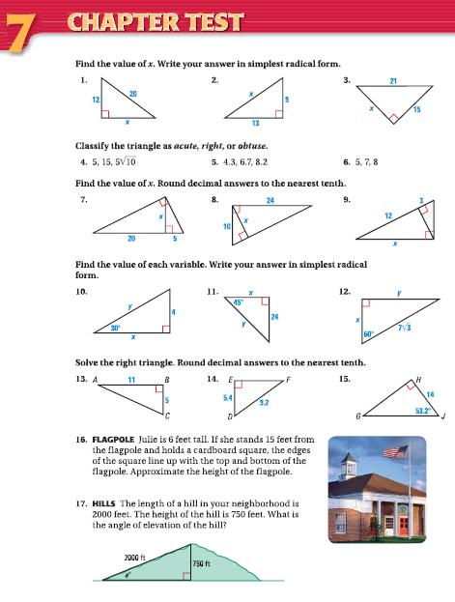
7.Review
498 #1-17 = 17

